Slide 1
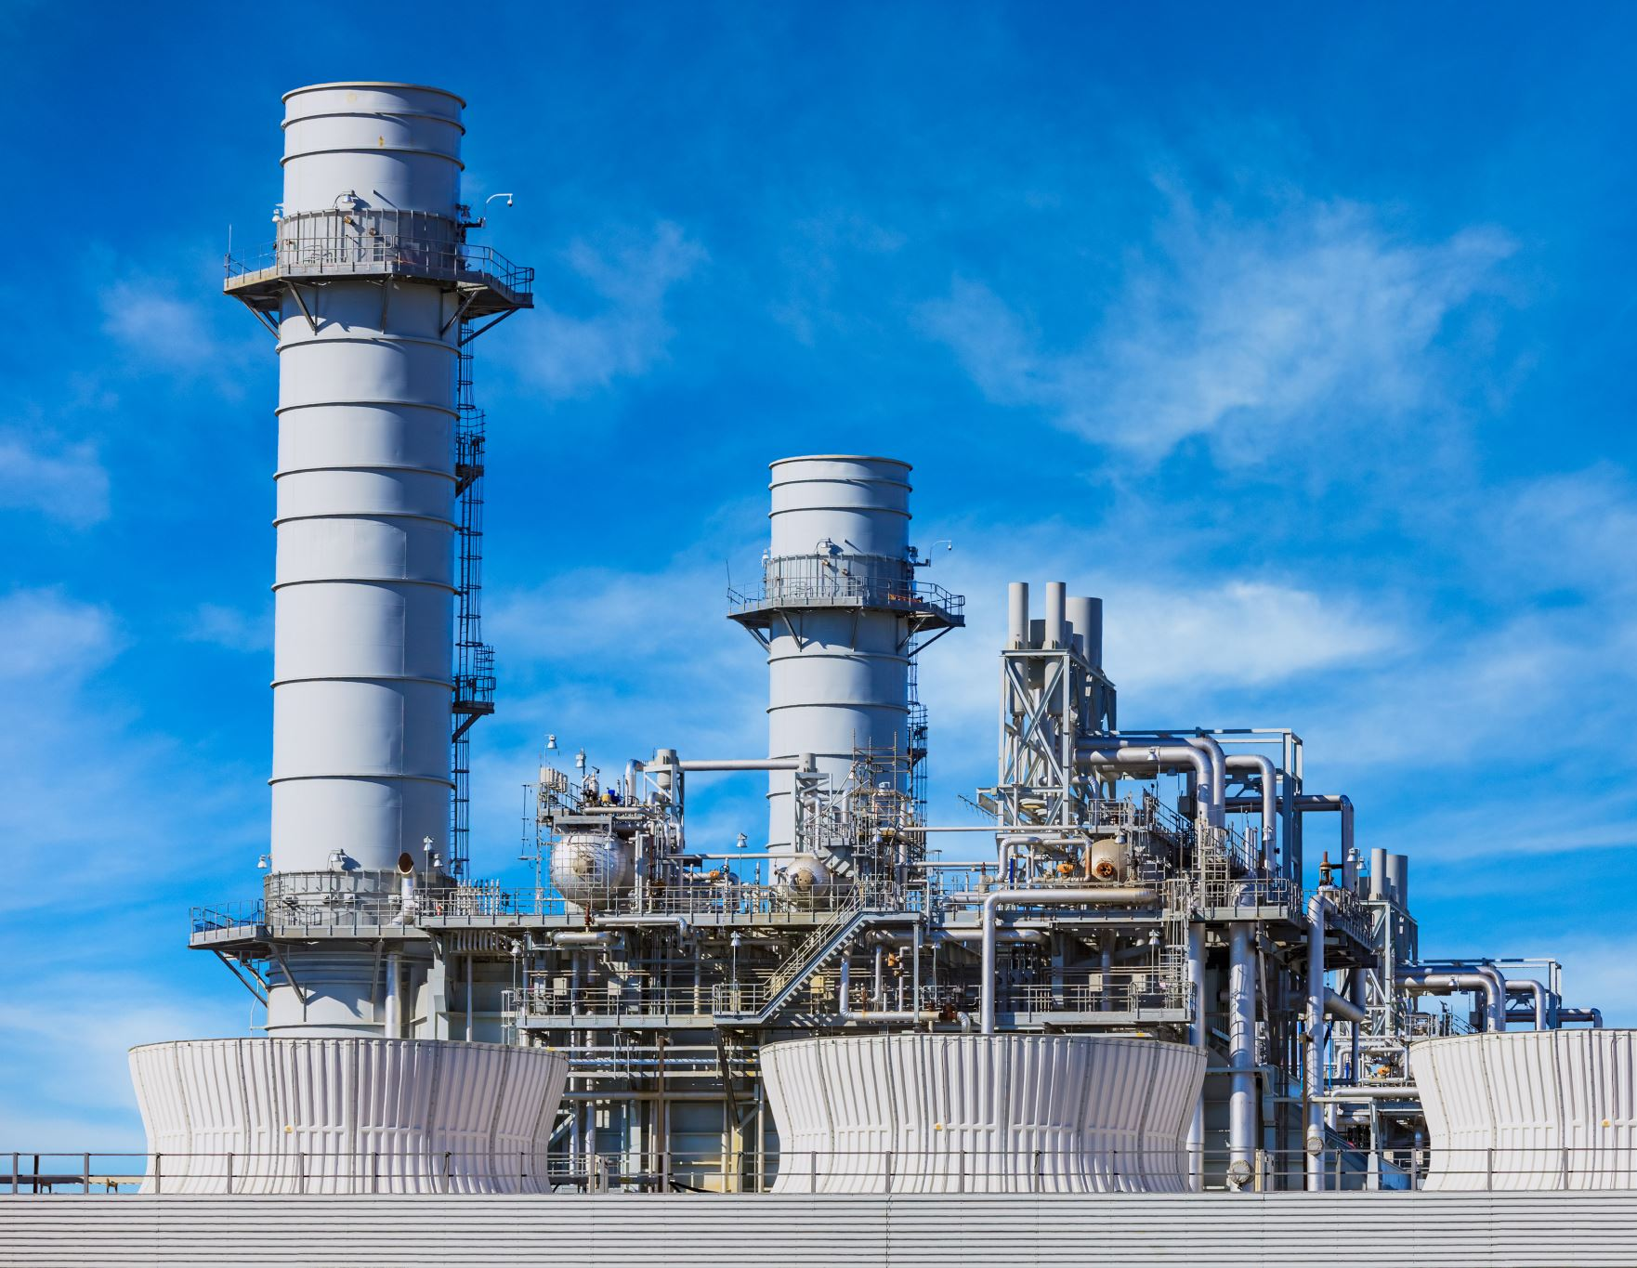
Monitoring and determining air quality in residential areas near factories
By : ayatullah hassan Mohamed

Slide 2
My vision
Trying to assess the risks that some residential neighborhoods may be exposed to and trying to find effective solutions

Slide 3
objective
Determine the locations of factories and the scope of influence of each factory
1
Determine the residential neighborhoods located in the areas affected by factories
2
Monitor and observe the spread of pollution during a specific period
3
Determine the pattern by which pollution changes across residential neighborhoods
4
Try to suggest effective solutions
5

Slide 4
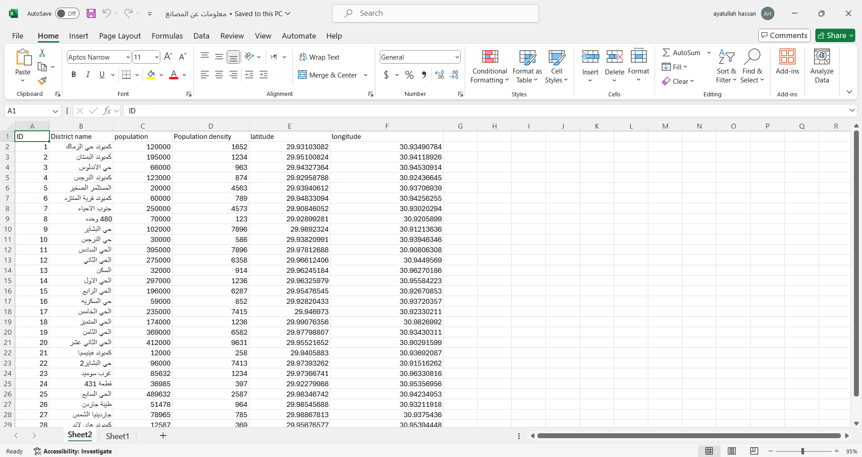
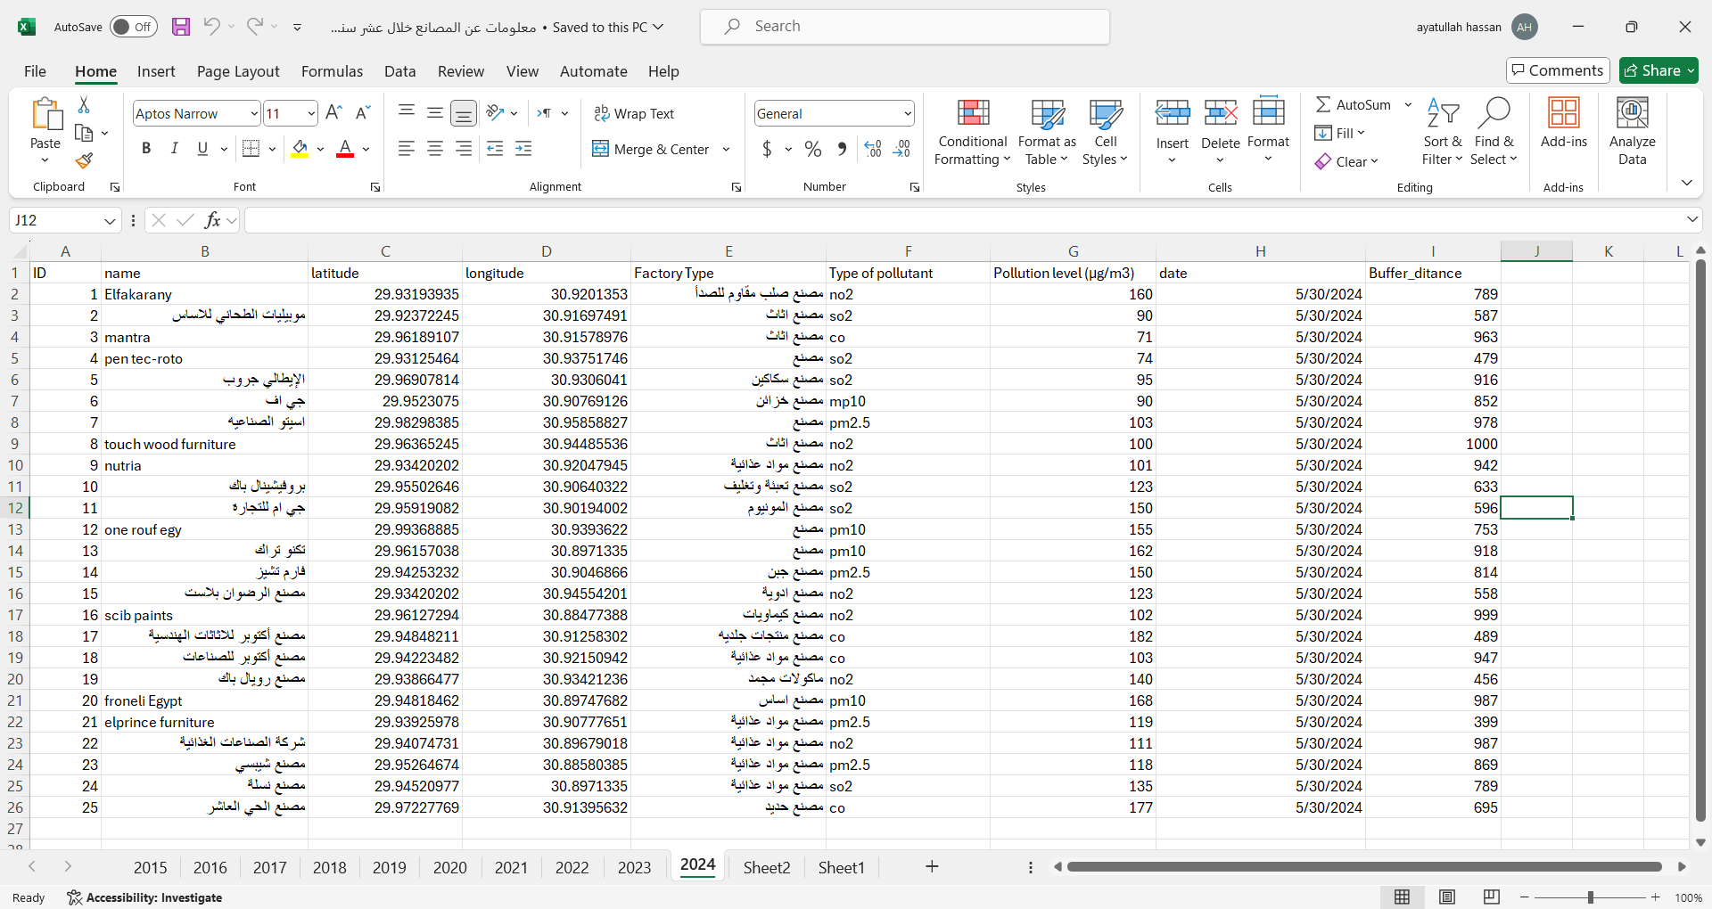
The data used and tools
Excel
I used Excel to record the geographical data of the factories in 6th of October City such as:
1-Pollution rate emitted from each factory
2-Type of pollutant
addition to data on residential neighborhoods such as:
1-Population number
2-Population density

Slide 5
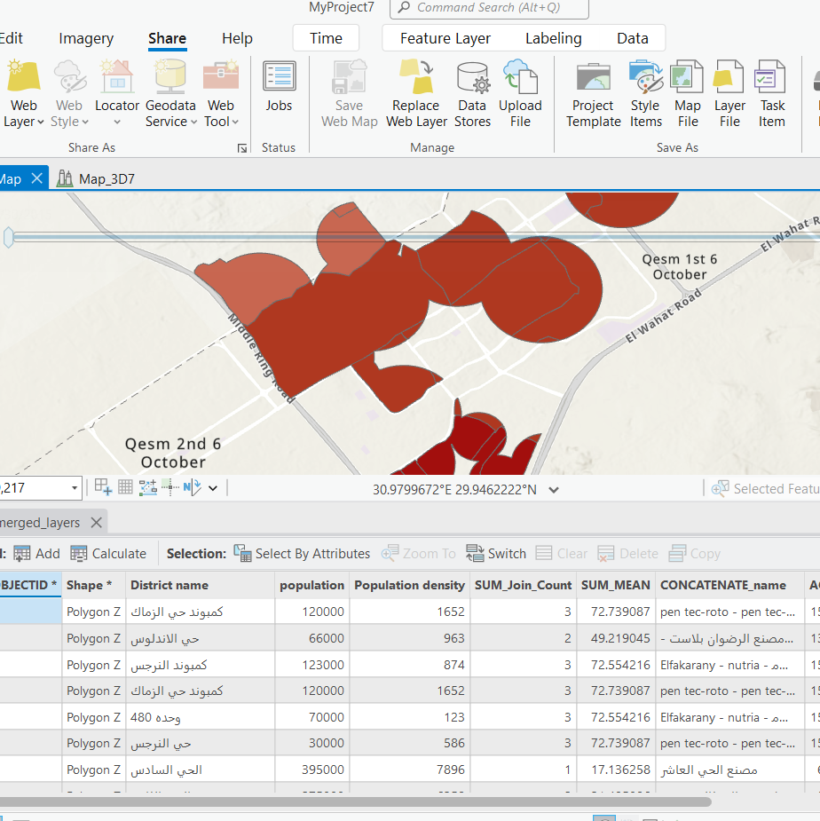
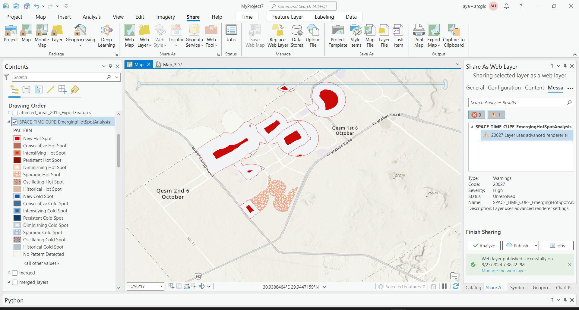
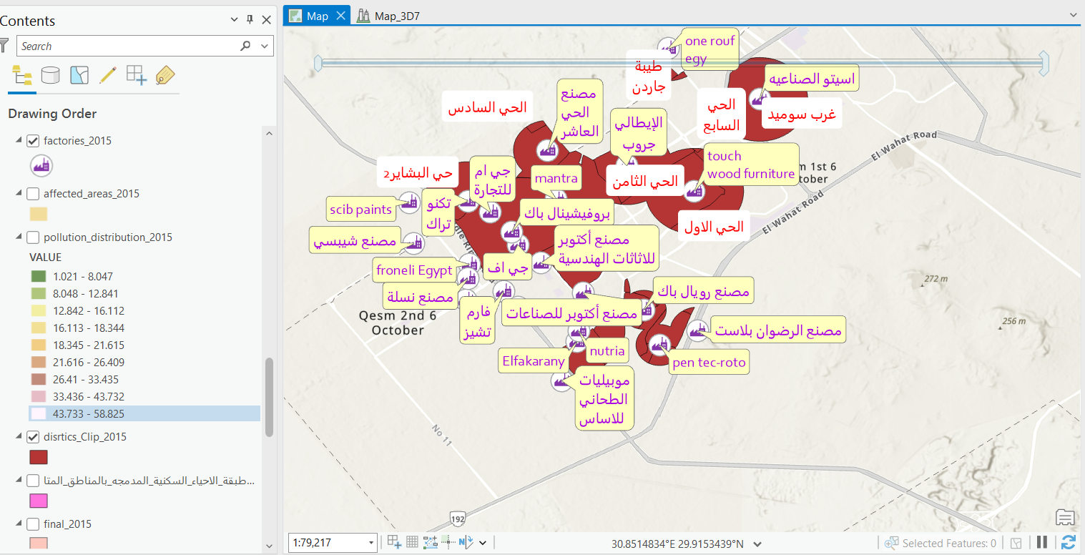
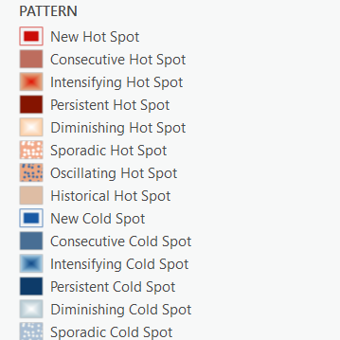
Using ArcGIS pro
I used the ArcGIS Pro program to represent and display this data in the form of layers and perform all types of analyses on it.

Slide 6
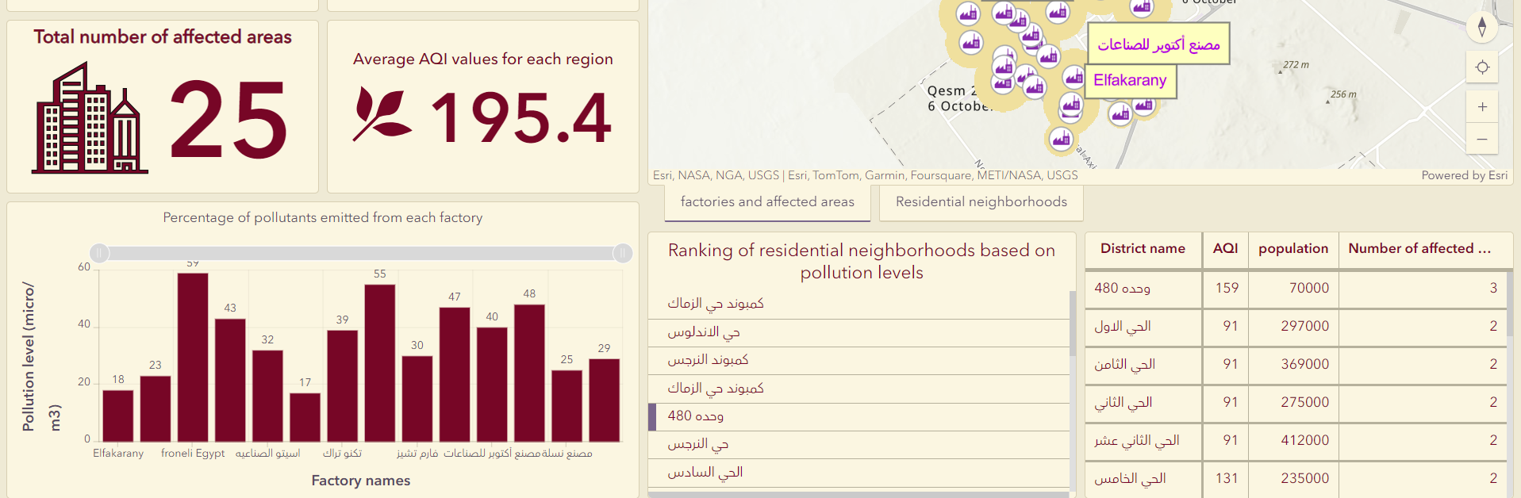

Using a dashboard to generate statistics

Slide 7
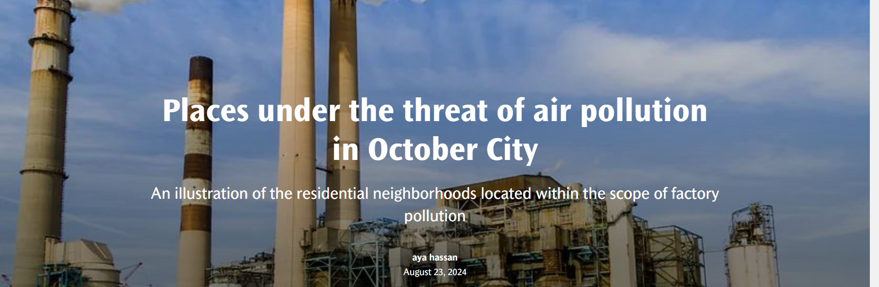
View results, analysis and suggestions for action through Story Map
Trying to make it easy and simple to understand.

Slide 8





workflow
1-collcetind data
2-analyz data
3-sharing data
4-make statics
5-visualyze

Slide 9
Conclusion
This is all about my project. I hope it is a useful project and you like it.

